Slide 1
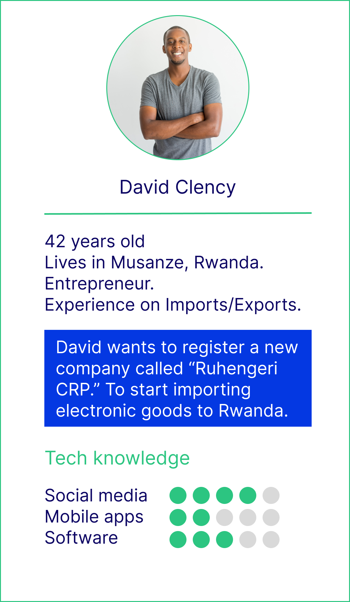
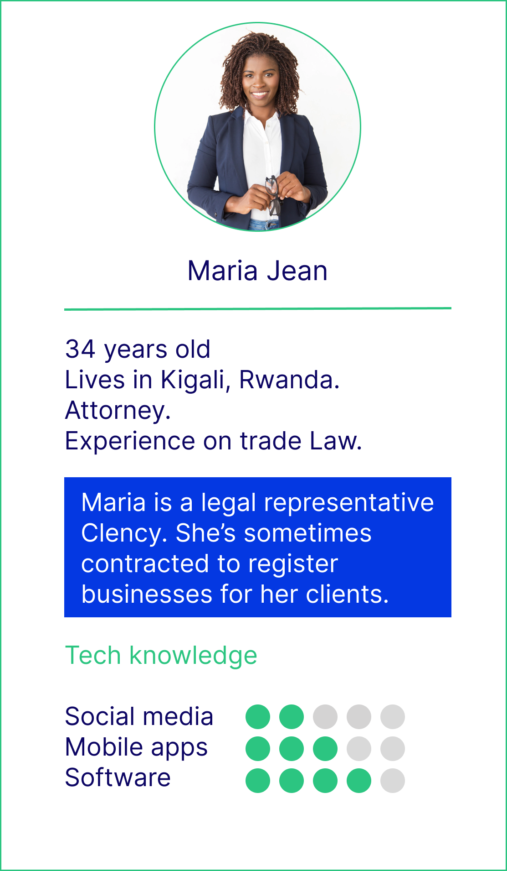
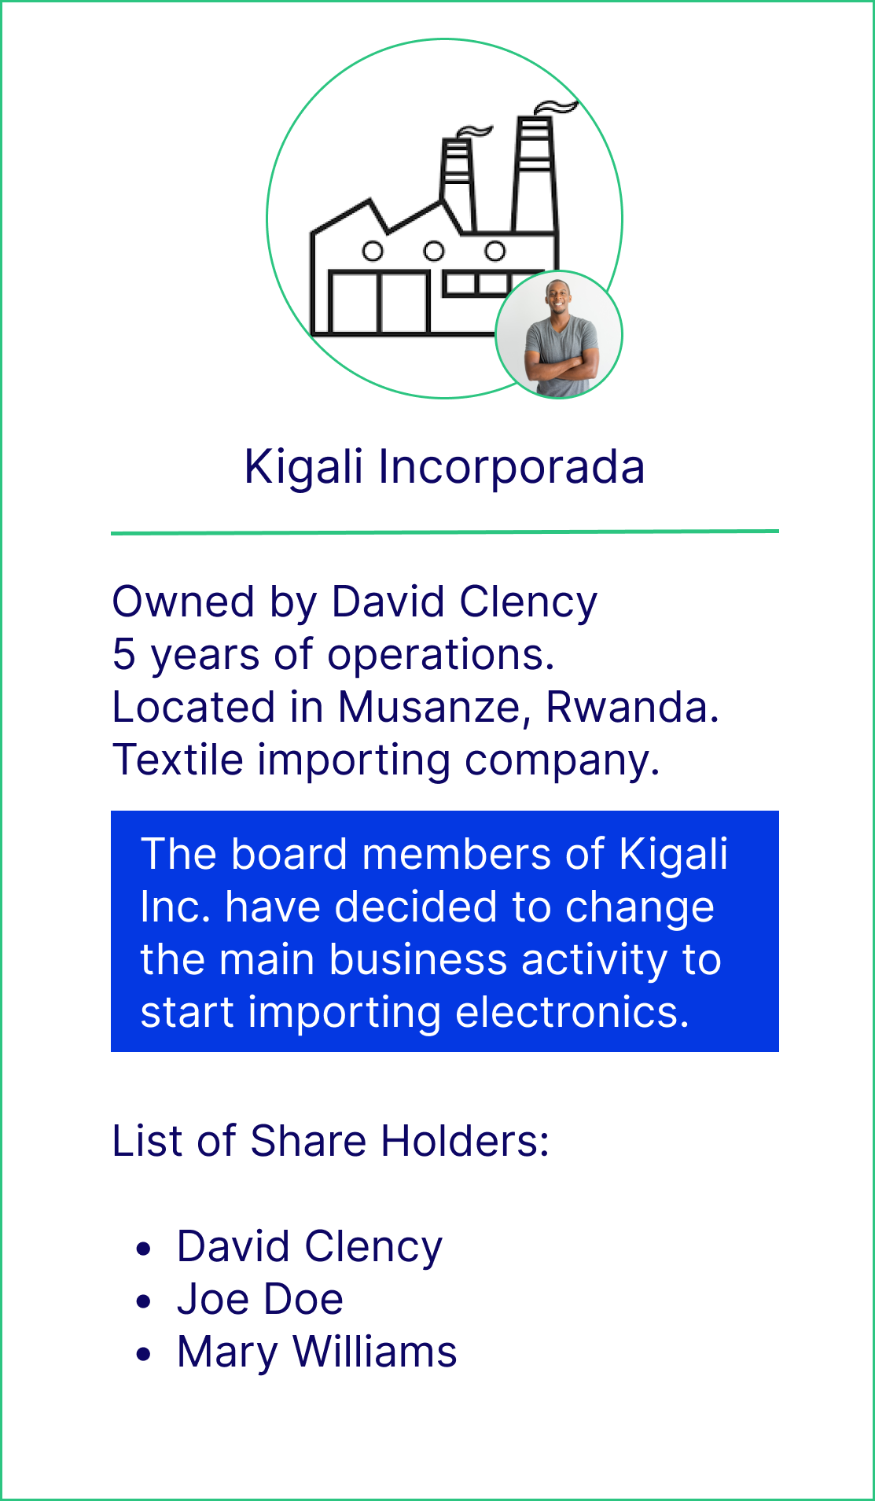
User persona template and examples
3 . Existing business: change in business activities
2 . New business: power of attorney
New business: entrepreneur
**The above personas were identified for the Extended Producer Responsibility service for Rwanda
Notes:
New business dealing in electronic & electrical equipment
importer, manufacturer
entrepreneur, SME, large company
Existing business dealing in electronic & electrical equipment
importer, manufacturer
entrepreneur, SME, large company
Existing business changing activity
importer, manufacturer
entrepreneur, SME, large company

